Slide 1
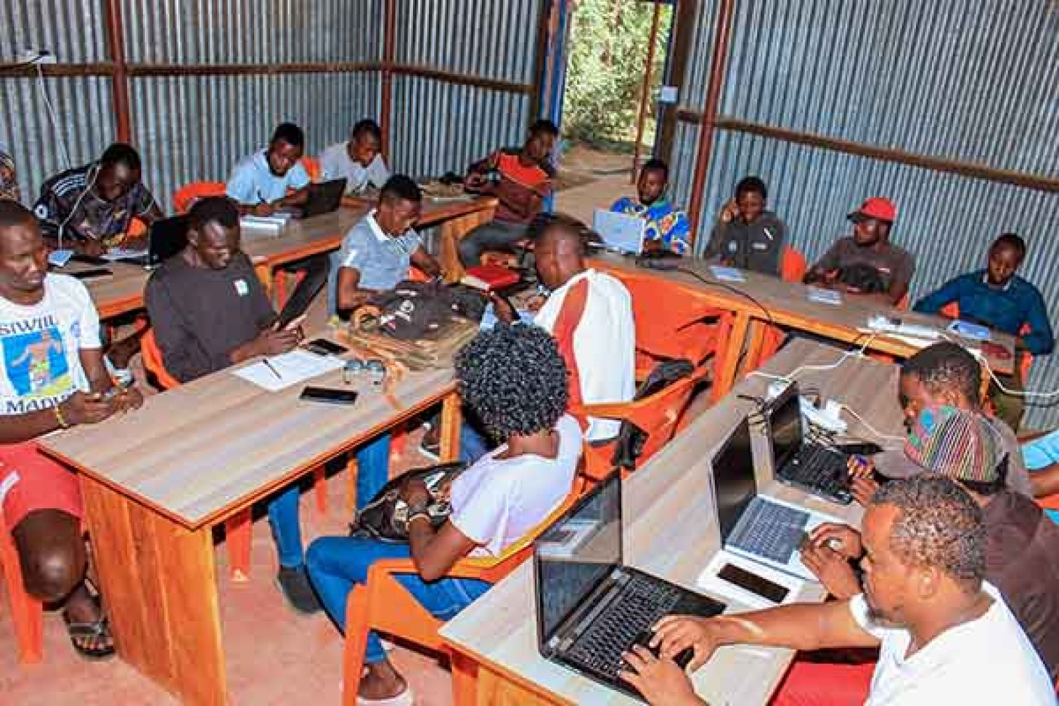

Youth Skills Training & Employment Outcomes in Kakuma Refugee Camp
Student Name: Daniel C. Anthony
Date: July 25th, 2025
Institution: AReL
https://joby.africa/wp-content/uploads/2024/12/Arel-Logo-560x315.png
Image:
https://refugeelife.org/templates/yootheme/cache/04/stage-photo-02-043ed428.jpeg

Slide 2
Introduction.
Kakuma Refugee camp is home to a diverse youth population facing economic challenges i.e., Somali, Sudanese, Rwandese, Ethiopians etc.
Therefore, skills training programs can help aim to empower youth with employable skills and improve their livelihood.
With that being said, this project help analyzes the real data provide by AReL to assess the effectiveness of the training programs within the Kakuma Refugee camp..

Slide 3
Project Objectives
The objectives of this project is to help;
Identify which skill training programs yield the highest employment for youth in Kakuma.
Determine the earning potential by skill and demographic groups within Kakuma.
Also, assess performance differences among training centers within Kakuma.
Explore how gender and age impact training and employment outcomes.

Slide 4
Methodology
Dataset: Trainee records including demographic details, training, and employment outcomes.
Some of the steps used in the retrieval of this data are:
Cleaning and transforming the data -by handled missing values and standardized categories using python.
Analyzing key metrics i.e. the completion rate, employment rate, and income.
Visualizing findings using Power BI dashboards.

Slide 5
Data Preparation Highlights
Addressed missing values with median age, and "Unknown" for blank fields.
Unified names for skill types and training centers for consistency.
Created age groups and standardized income fields for analysis.

Slide 6
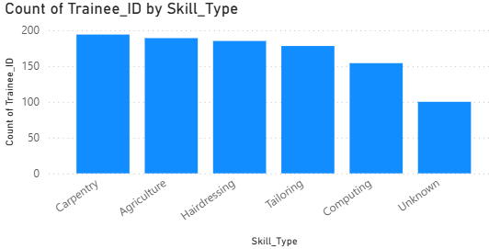
Training Program Participation
The most popular training programs include Carpentry, Agriculture, and Hairdressing; meanwhile the least are tailoring, computing, and the unknown.

Slide 7
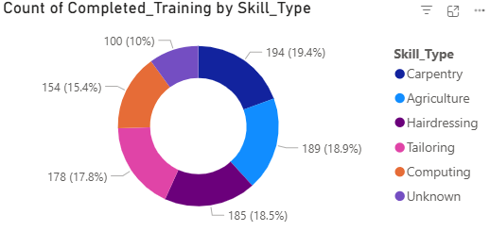
Completion Rates by Skill Type
Skill type i.e. carpentry has the highest completion rate, whereas skill type computing struggled with more dropouts, thus indicating potential challenges such as curriculum difficulty, resource gaps, or trainee readiness.

Slide 8
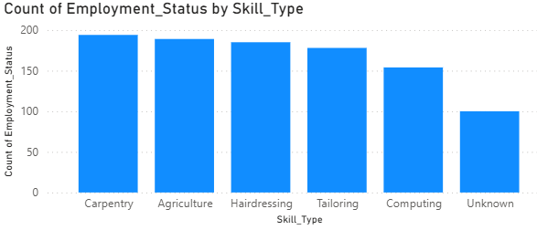
Employment Outcomes by Skill Type
Graduates of carpentry most frequently found employment easily or at most cases get self-employment.
Some fields showed higher unemployment rate, especially tailoring and computing.
Notes:
tailoring and computing face higher unemployment rates, possibly due to limited local opportunities or skill mismatches, highlighting areas needing enhanced job placement support and market linkage.

Slide 9
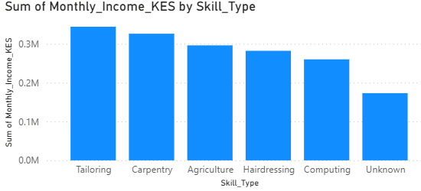
Income Analysis by Skill Type
Certain skills, for instance tailoring, yield higher earnings as compared to other skills.
Notes:
Certain skills, such as tailoring, generate higher earnings for trainees compared to other vocational areas. This suggests that tailoring offers strong income potential maybe due to steady demand and viable business opportunities within the community.

Slide 10
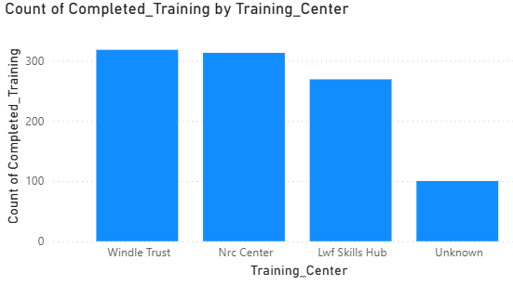
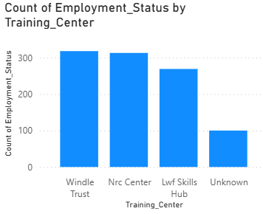
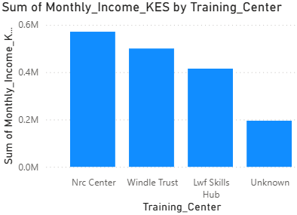
Training Center Effectiveness
Training center i.e.,Windle Trust consistently shows high completion rate and high job placement.
On the other hand, training center LWF skills hub need some targeted support in order to improve it outcomes, and Nrc center leads in total trainee income, followed by Windle Trust, thus indicating a better employment opportunities among graduates.
Notes:
Windle Trust consistently achieves high training completion and job placement rates, which then demonstrate effective program delivery and strong graduate support. Meanwhile, LWF Skills Hub needs targeted interventions to boost its completion and employment outcomes. NRC center leads in total trainee income, followed by Windle Trust, thus indicating that its graduates access better employment opportunities and higher earnings post-training.

Slide 11
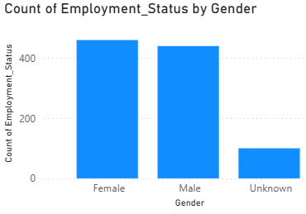
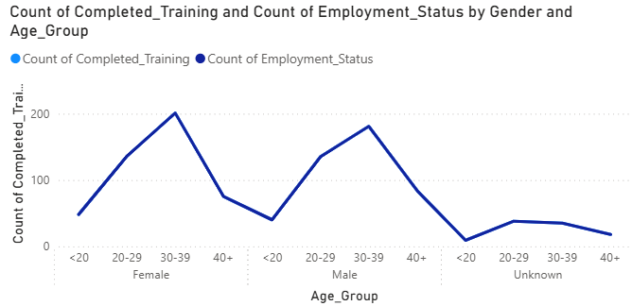
Demographic Impact
Female gender participants have higher completion/employment rates for certain skills than the other genders.
The training completion and employment are most concentrated among adults aged 30-39 for both males and females, thus can help inform targeted program support for other age group.

Slide 12
Key Insights & Summary
The most in-demand and marketable skills identified are;
Carpentry,
Agriculture, and
Hairdressing.
[Training centers e.g., Windle Trust and Nrc excelled in graduation and placement rates than other centers.
Earnings potential varies notably across groups and others such as skills.
Gender and age influence outcomes i.e., younger trainees aged 20-39 show distinct patterns in success rates, thus underscoring the need for tailored program support.

Slide 13
Recommendations
Centers should;
Expand training slots for high-employment skill areas i.e., carpentry and tailoring.
Provide additional support to underperforming centers like LWF skills hub so as to improve completion/job placement rates.
Address gender and age disparities by tailoring programs to underperforming groups, especially younger and older trainees.

Slide 14
Conclusion & Next Steps
In conclusion, data-driven improvements can significantly enhance youth livelihoods in Kakuma.
Therefore, I recommend periodic monitoring and continuous data analysis for centers and skills provision within Kakuma.
Q&As.
Thank you for your attention & time.

Slide 15
Reference.
https://joby.africa/wp-content/uploads/2024/12/Arel-Logo-560x315.png
https://refugeelife.org/templates/yootheme/cache/04/stage-photo-02-043ed428.jpeg

